Slide 1
South Carolina School Finance reform
Aaron Smith
Reason Foundation
aaron.smith@reason.org

Slide 2
About Reason Foundation
Reason Foundation is a national 501(c)(3) public policy research and education organization with expertise across a range of policy areas, including public sector pensions, transportation, infrastructure, education, and criminal justice.
The Center for Student-based Budgeting at Reason Foundation helps policymakers, school district officials and other stakeholders design and implement education finance reforms that put students first.
For more information about Reason Foundation, visit reason.org.

Slide 3

Approach to School Finance
Notes:
Fairness: Dollars are allocated based primarily on student needs. This includes both horizontal and vertical equity.
Transparency: Dollars are allocated in a transparent manner. Robust financial reporting infrastructure.
Autonomy: Spending decisions are pushed down to the local level in exchange for accountability for outcomes.

Slide 4
Agenda
Highlight key shortcomings of South Carolina’s school finance formula.
Provide a case study of California’s Local Control Funding Formula as a model for reform.
Review opportunities for school finance reform.

Slide 5
Key Questions to Consider
Who should ultimately decide how education dollars are spent?
How can financial transparency give stakeholders access to data to make more informed decisions for kids?
Are all students getting a fair share of the education funding pie?
Are South Carolina’s education dollars allocated strategically?
What role should local dollars play in South Carolina’s school finance system?

Slide 6
South Carolina school finance: key shortcomings

Slide 7
Analyzing School Finance Systems
Allocation
Transparency
Equalization
Allocation: How dollars are delivered to districts and schools.
Funding: The mix of revenue sources and the extent to which local dollars are equalized.
Transparency: A formula’s level of complexity and the extent to which financial data are reported.
Notes:
Three lens from which to view school finance systems, which are inter-related. Today I will focus on the allocation aspect and briefly touch upon the others.
Allocation affects both equity and autonomy.
Equalization affects equity.
Transparency can shine light on both problems and good practices and be used as a tool for district officials, board members, state officials, etc.

Slide 8
Types of School Finance Formulas
Student-based: Allocations are based on individual students and their level of need.
Resource-based: Allocations are based on a set of inputs such as staffing positions.
Program-based: Dollars are allocated for specific programs such as professional development and school safety.
Hybrid: Some combination of these above approaches.
Notes:
There are different ways to categorize school finance systems.
Student: Estimate a foundation amount for an average pupil and then adjust that amount for student characteristics/need.
Resource: Driven by estimated cost of particular inputs (salaries, supplies, etc.).
Program: Allocations restricted to particular programs.

Slide 9
Student Based (28)
AK, AZ, AR, CA, CO, CT, FL, HI, IN, IA, KY, MD, MI, MN, MI, NE, NH, NJ, NM, NY, ND, OH,OK,OR, RI,TX, UT, VT
Resource Based (9)
AL, DE, ID, IL,SD,TN, WA,WV, WY
Program Based (1)
WI
Hybrid (10)
GA, LA, ME, MA, MS, MT, NV, NC, SC, VA
Other (2)
KS, PA
South Carolina employs a hybrid school finance system that relies heavily on categorical allotments.
Source: Data and classifications based on EdBuild’s Custom Reports tool, which can be found at http://funded.edbuild.org/reports
Notes:
-The general trend is for states to move toward student-based systems
-States such as GA, LA, MS, NC, NV, IL, TN have recently or are currently evaluating potential reforms.
Student-based systems:
Tend to be more flexible.
Calculations are clear and transparent.
Responsive to changing in student demographics.
Responsive to evolving local needs.
Resource-based
Tend to represent “frozen in time” vision of education.
Often come with strings attached.
Can be inequitable (e.g. staffing position allocations)
Program-based
1) Tend to be the least responsive/flexible way to fund education.

Slide 10
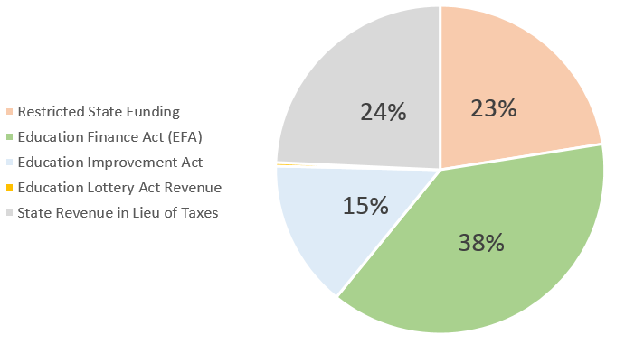
State Education Revenue
Source: Calculations made using data provided on South Carolina Department of Education’s website. https://ed.sc.gov/
Notes:
The good news is that a mechanism to deliver state education dollars already exists within South Carolina’s Education Finance Act. This delivers about 38% of state education revenue.
The Education Improvement Act and Restricted State funding combine for about the same—38%.

Slide 11
Education Finance Act Weights
Kindergarten 1.00
Primary 1.00
Elementary 1.00
High School 1.00
Trainable Mentally Handicapped 2.04
Speech Handicapped 1.90
Homebound 1.00
Emotionally Handicapped 2.04
Educable Mentally Handicapped 1.74
Learning Disabilities 1.74
Hearing Handicapped 2.57
Visually Handicapped 2.57
Orthopedically Handicapped 2.04
Vocational (Grades 9-12) 1.29
Autism 2.57
High Achieving .15
Limited English Proficiency .20
Academic Assistance .15
Pupils in Poverty .20
Dual Credit Enrollment .15
Source: South Carolina Department of Education’s 2018-2019 Funding Manual.

Slide 12
Education Improvement Act
Adept
Aid to Districts – Technology
Arts in Education
Adoption List of Formative Assessment
Refurbished K-8 Science Kits
Industry Certification Credentials
Career and Technology Education
National Board Salary Supplement
Teacher of the Year Award
Reading Coaches
Students at Risk of School Failure
Four-Year-Old Early Childhood Program
Child Early Reading Development and Education Program
Teacher Salary Increase
Teacher Salary Fringe
Adult Education
Summer Reading Program
Technical Assistance – State Priority Schools
Teacher Supplies
Special Education – MOE
EEEDA – Supplies and Materials – Career Awareness
EEDA Career Specialists
Aid to Districts
Source: South Carolina Department of Education’s 2018-2019 Funding Manual.
Notes:
EIA and Restricted state funding are separate categorical allotments that:
Have their own allocation methodologies,
Have their own set of rules and restrictions, and
Appear to live outside of the equalization formula.
Example: Aid to Districts, Technology
Guidelines
Funds may only be used for the following purposes: (1) To improve external connections to schools,
with a goal of reaching at least 100 kilobits per second, per student in each school by 2019; (2) To
improve internal connections within schools, with a goal of reaching at least 1 megabit per second,
per student in each school by 2019; (3) To develop or expand one-to-one computing initiatives; or (4)
with *prior permission of the K-12 Technology Initiative Committee, and if the district has completed
items (1) - (3), other technology-related uses.
The following steps should be followed in order to request permission to utilize funds for “other
technology-related uses.” XYZ

Slide 13
Restricted State Funding
EEDA Career Specialists
Student Health and Fitness
Handicapped Transportation –Bus Driver Aides
Handicapped Transportation –Special Needs Students Contract Reimbursement
Home Schooling
Child Early Reading Development and Education Program
Reading Coaches
Student Health and Fitness – Nurses
DSS SNAP E&T Program
School Bus Driver Salary
EAA Bus Driver Salary and Fringe
Transportation Workers Compensation
Fringe Benefits Employer Contributions
Retiree Insurance
Teacher Supply
Education License Plates
Residential Treatment Facilities
Maintenance of State Financial Support (MFS) -Tier I Maintenance of State Financial Support (MFS) - Tier II
Source: South Carolina Department of Education’s 2018-2019 Funding Manual.
Notes:
Similar: All have 1) Separate allocation methodology, and 2) Separate requirements for spending.

Slide 14
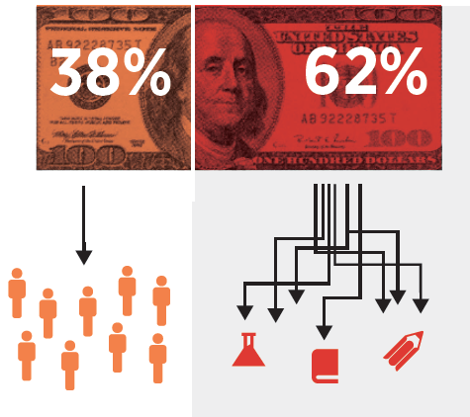
Problems with Categorical Funding
One-size-fits-all solution
Compliance culture over innovation
Can cause funding inequities
Diminishes transparency
Diminishes accountability
States are moving toward local autonomy over education dollars.
Districts are increasingly adopting funding models that give school leaders more say over spending decisions.
Notes:
There isn’t one “right way” to spend education dollars. Districts/schools with similar student populations can spend dollars in the exact same way and get vastly different results.
Districts and schools can’t make locally responsive tradeoffs in spending.
Tying strings results in less integrated funding, dollars can’t be used to improve quality of schools overall. You want to see local officials using dollars to meet students where they are.
Often delivered “outside” of the equalization formula.
Alternative: Look very carefully at investments and outcomes with flexibility in between.

Slide 15
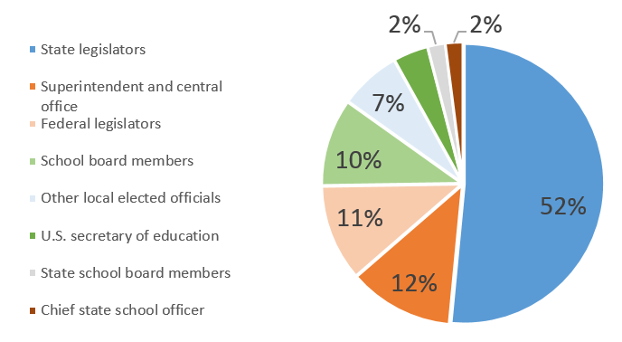
Who is the biggest obstacle to making spending decisions that best address your students’ needs?
Source: Education Week Research Center, 2019.
Notes:
Legislators: 52%
Central Office/Superintendent: 12%
Federal legislators: 11%
The fact is schools have little discretion over operating dollars: a recent study by AIR and U.S. ED put that figure at 8%.
Education Week Research Center in August fielded an online survey to a nationally representative sample of school principals and district-level administrators. We heard from more than 700 respondents from all 50 states and the District of Columbia, capturing opinion from a wide swath of districts—rural, urban, and suburban; large and small; higher- and lower-income.

Slide 16
Other Shortcomings to Note

Slide 17
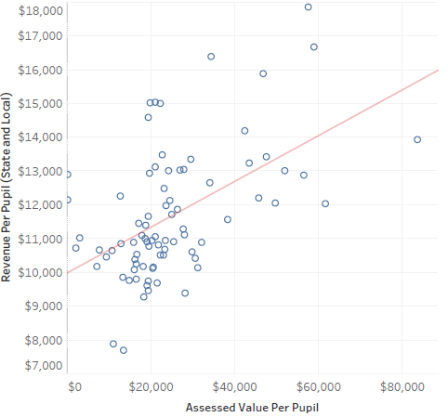
District Comparison: Revenue vs. Assessed Valuation
Source: 2017-18 revenue data based on figures obtained from South Carolina Department of Education’s website. https://ed.sc.gov/
Notes:
Comparing state and local revenue per-pupil on the Y-axis with assessed valuation per-pupil on the X-axis.
Complex topic in South Carolina but it appears as though local dollars aren’t be sufficiently equalized.
Districts with higher levels of assessed value per pupil tend to generate more state and local dollars.

Slide 18
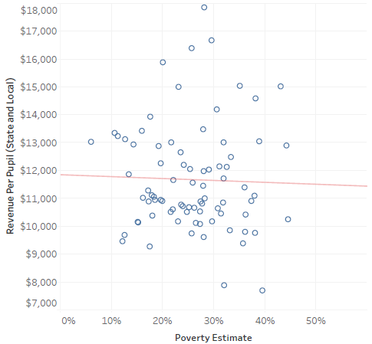
District Comparison: Revenue vs. Poverty Estimates
Source: 2017-18 revenue data based on figures obtained from South Carolina Department of Education’s website. https://ed.sc.gov/. 2017 poverty estimates for districts obtained from U.S. Census Bureau’s Small Area Income and Poverty Program (SAIPE)
Notes:
State and local revenue per-pupil on the Y-axis and federal poverty estimates on the X-axis.
School finance system doesn’t appear to be directing more dollars to students in poverty.

Slide 19
Case Study: California’s Local control funding formula

Slide 20

LCFF: Background
2013: Local Control Funding Formula signed into law with bipartisan support.
Primary policy aims:
Increase local flexibility over dollars.
Improve funding equity.
Source: A Preliminary Analysis of California’s New Local Control Funding Formula (
Notes:
Prior to LCFF, education dollars had strings attached.
Categorical allotments were 1/3 of state dollars
More than 50 categorical allotments at the time including: Oral Health Assessments, Peer Assistance and Review, Community-based English, Summer School programs, Textbooks, etc.
Dollars were not deployed strategically based on student needs.
The LCFF sought to change to push spending decisions down to the local level and improve funding equity, targeting specific student groups.

Slide 21
LCFF Theory of Action
I. Student-based Funding
II. Local flexibility
III. Stakeholder engagement
More equitable and coherent allocation of resources
Improved outcomes
Accountability, Support, & Intervention
Source: Paving the Way to Equity and Coherence? The Local Control Funding Formula in Year 3
Notes:
What LCFF seeks to do.

Slide 22
Eliminated Programs
AP Fee Waiver
Alternative Credentialing
High School Exit Exam Tutoring
School Age Families
Categorical Programs for New Schools
Certificated Staff Mentoring
Charter School Block Grant
Civic Education
Community-Based English Tutoring
Community Day School
Deferred Maintenance
Economic Impact Aid
Educational Technology
Gift and Talented Education
Grade 7-12 Counselling
High School Class Size Reduction
Instructional Materials Block Grant
International Baccalaureate Diploma Program
National Board Certification Incentives
Oral Health Assessments
Physical Education Block Grant
Principal Training
Professional Development Block Grant
Professional Development for Math and English
School and Library Improvement Block Grant
School Safety
School Safety Competitive Grant
Staff Development
Student Councils
Summer School Programs
Teacher Credentialing Block Grant
Teacher Dismissal
Source: California’s Legislative Analyst’s Office website
Notes:
About ¾ of categorical programs were eliminated under LCFF.

Slide 23
Retained Programs
Adults in Correctional Facilities
After School Education and Safety
Agricultural Vocational Education
American Indiana Education Centers
Assessments
Child Nutrition
Foster Youth Services
Mandates Block Grant
Partnership Academies
Quality Education Improvement Act
Special Education
Specialized Secondary Programs
State Preschool
Source: California’s Legislative Analyst’s Office website
Notes:
SPED preserved as categorical grant outside of main formula, dollars delivered not based on students but on census counts of ALL students, not just those with disabilities.
Likely retained SPED as categorical funding due to their system of SELPAs. Administer SPED dollars and certain programs for groups of districts. This is something some policymakers in California would like to change.
Other retained categoricals are specialized programs such as American Indian Education Centers and Adults in Correctional Facilities.

Slide 24
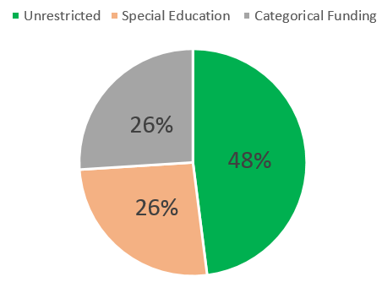
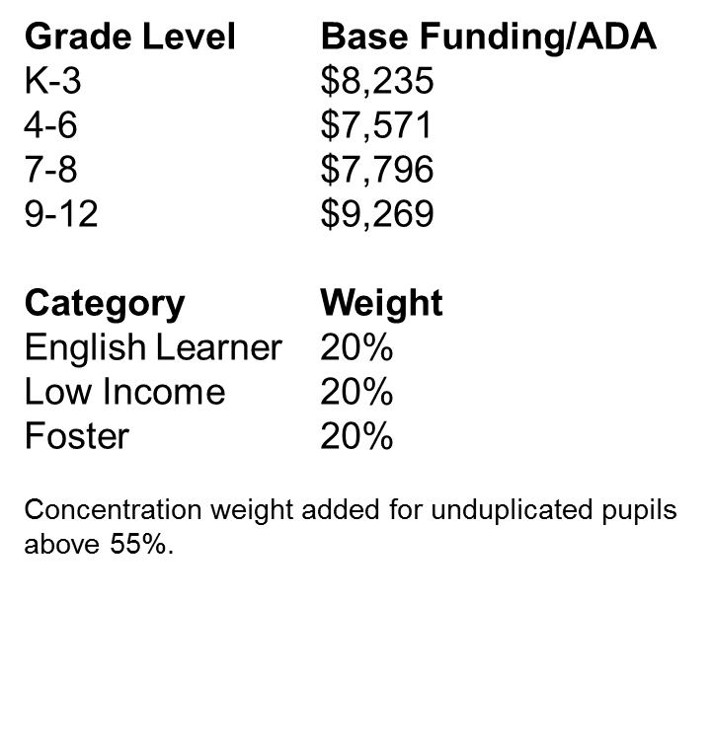
Local Control Funding Formula
48% of categorical funds became unrestricted.
Sources: California Department of Education website and A Preliminary Analysis of California’s New Local Control Funding Formula
Notes:
48% of categorical funds were pushed into a weighted-student formula.
The WSF has a base level that varies by grade level and three categories: EL, Low-Income, Foster Youth.
Also provides a Low-income concentration grant equal to 50 percent of the adjusted base grant multiplied by ADA and the percentage of targeted pupils exceeding 55 percent of a local educational agency’s (LEA) enrollment
Transportation: Maintains Home-to-School Transportation and Targeted Instructional Improvement Block Grant funding as add-ons to the adjusted base grants in the LCFF target, based on amounts received in 2012–13, and requires that 2012–13 expenditure levels continue to be maintained for Home-to-School Transportation.

Slide 25
Local Control Funding Formula: Requirements
Base, supplemental, and concentration funds are all unrestricted—no spending requirements. But LCFF had some guidance:
Proportionality Requirement: Districts must “increase or improve services” for targeted students in proportion to the increase in funds for these students.
Engagement: Must engage parents, community members, students, and educators for input on spending.
Local Control Accountability Plan: Each district must have a three-year plan (LCAP) that “describes the goals, actions, services and expenditures…that address state and local priorities.”
Notes:
First, districts must meet the law’s “proportionality requirement,” which requires districts to “increase or improve services for [targeted student populations] in proportion to the increase in funds apportioned on the basis of the number and concentration of [targeted students]” (Cal. Ed. Code, 2013a). However, “the exact meaning and regulatory effect of this proportionality clause is currently unknown” For example, how does one increase services by a certain percentage when services are not measured in units such as hours or dollars? Moreover, an increase in services does not necessarily mean an increase in expenditures.
Local spending plans be developed with input from parents, community members, students, and educators. The law requires that the vision, plans, strategies, and expenditures be based on and organized around local goals, but with reference to and measurement of the eight state priorities. Districts are also charged with developing a Local Control Accountability Plan (LCAP). The LCAP, updated annually and approved by the local County Office of Education (COE), measures district progress based on multiple metrics. LEAs that are struggling or failing to achieve targets are offered support or intervention
Third, minor spending restrictions include that districts must maintain their current levels of spending on transportation and adult education, at least in the short term.
The LCAP is a three-year plan that describes the goals, actions, services, and expenditures to support positive student outcomes that address state and local priorities. The LCAP provides an opportunity for local educational agencies (LEAs) to share their stories of how, what, and why programs and services are selected to meet their local needs
The LCAP is organized around the state’s eight state priorities: basic services and conditions, academic content and standards, parent involvement, student achievement, student engagement, school climate, course access, and other student outcomes. For clarity and ease of use, many districts have collapsed these into three mega-categories—school climate, student achievement, and parent engagement—around which they build goals and strategies. (The Local Control Funding Formula (LCFF): What Have We Learned After Four Years of Implementation?)

Slide 26

Transition
Estimated to take eight years.
Funding during phase-in based on prior year funding as well as the new “target” amount.
Difference between these amounts is the “need” or “gap.”
Districts not funded at target received a percentage of its gap based on appropriations.
Source: California Department of Education website.
Notes:
Context is different for every state.
Implementation policy is based on numerous factors and California’s was unique in several ways (centralized funding system)
A hold harmless provision ensured that no district received less state aid than in the year prior to the enactment of the LCFF. Basic aid or excess revenue districts benefitted from this hold harmless provision

Slide 27
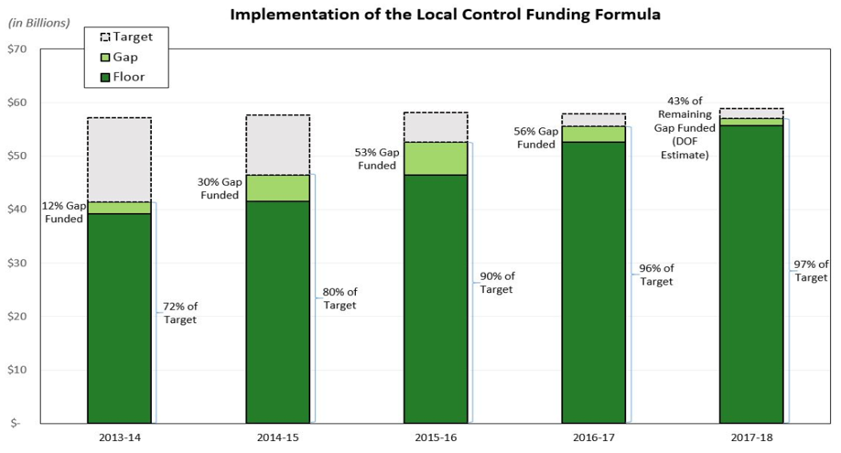
Source: California Department of Education website.
Notes:
Every year during implementation the legislature closed the gap between the floor and target with “gap funding” for each district until the target was fully funded.
Estimated cost to fully fund LCFF: $18 billion
Gap appropriation made each year
Remaining need to fully fund the formula shrinks each year
As of the 2017–18 Budget Act, school districts and charter schools are receiving on average 97 percent of their LCFF targets. On an individual LEA basis, however, there is a wide variation on how much of their full LCFF target funding individual school districts and charter schools are receiving. This variation is due to the fact that when LCFF implementation began, individual districts and charter schools were all at different distances from their LCFF targets.

Slide 28
Local Control Funding Formula Research Collaborative (LCFFRC)
Including researchers from:
University of Southern California
Loyola Marymount University
Stanford University
Studies Include:
Superintendents Speak: Implementing the Local Control Funding Formula
The Local Control Funding Formula (LCFF): What Have We Learned After Four Years of Implementation?
How Stakeholder Engagement Fuels Improvement Efforts in Three California School Districts
Paving the Way to Equity and Coherence? The Local Control Funding Formula in Year 3
Key Studies by Other Researchers:
Toward a Grand Vision: Early Implementation of California’s Local Control Funding Formula (SRI International, J. Koppich & Associates)
The Steep Road to Resource Equity in California Education: The Local Control Funding Formula After Three Years (The Education Trust-West)
Taking Stock of California’s Weighted Student Funding Overhaul: What Have Districts Done with their
Spending Flexibility? (Edunomics Lab at Georgetown University)
Money and Freedom: The Impact of California’s School Finance Reform (Learning Policy Institute)
A Preliminary Analysis of California’s New Local Control Funding Formula (SRI International)
The following section draws data and findings from these research sources.
Notes:
It’s still early, but initial research can help shine light on the effects of California’s school finance reform.
There have been a lot of great studies published.
Local Control Funding Formula Research Collaborative has studied the issue closely.
As have researchers from organizations such as Educatino Trust-West, Learning Policy Institute, and Georgetown University’s Edunomics Lab.

Slide 29
LCFF Research: Emerging Themes
Widespread support for the new funding system.
Cultural shifts within school districts.
Increased community engagement.
Evidence of customization.
Focus on equity.
Challenges.
Notes:
There are several emerging themes that arise from the research. Plus several key shortcomings/challenges of LCFF.

Slide 30
LCFF Research: Emerging Themes
Widespread support for the new funding system.
Cultural shifts within school districts.
Increased community engagement.
Evidence of customization.
Focus on equity.
Challenges.

Slide 31
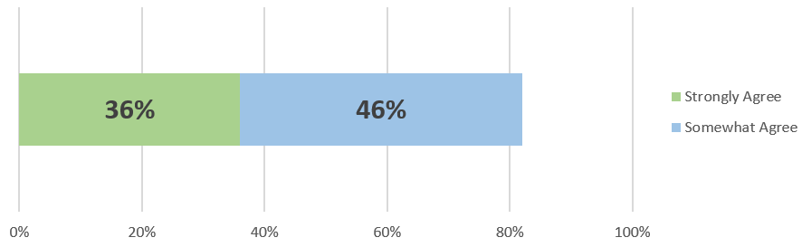
82% of superintendents strongly or somewhat agree that the LCFF is leading to greater alignment among goals, strategies, and resource allocation decisions.
Notes:
Local Control Funding Formula Research Collaborative did a comprehensive survey of California superintendents, which largely gave LCFF high marks.

Slide 32
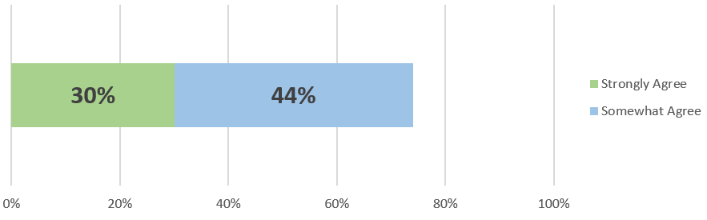
74% of superintendents strongly or somewhat agree that the fiscal flexibility granted by LCFF has enabled their district to spend in ways that match local needs.
Notes:
Districts appear to be making tradeoffs with how funds are used.

Slide 33
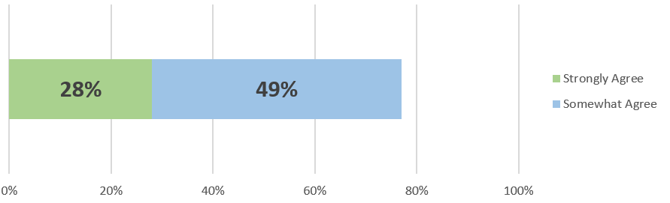
77% of superintendents strongly or somewhat agree that the LCFF has enabled their district to rethink budget priorities.
Notes:
Not much room to maneuver before LCFF.

Slide 34
Widespread Support
"I think [the LCFF] is a wonderful direction. I wholeheartedly support what it aspires to do in terms of local control, brining in the community to write their story [about] what they want for their kids."
LCFFRC researchers found “little enthusiasm” among district officials for returning to categorical funding.
Of those familiar with law 72% of likely voters and 84% of parents viewed it positively.
Notes:
“This is a really big deal. I love it. We’re finally [asking] who are the students with the highest need and how do we address those needs?”(A Preliminary Analysis of California’s New Local Control Funding Formula)

Slide 35
LCFF Research: Emerging Themes
Widespread support for the new funding system.
Cultural shifts within school districts.
Increased community engagement.
Evidence of customization.
Focus on equity.
Challenges.

Slide 36
Cultural Shifts within School Districts
“We’re finally [asking] who are the students with the highest need and how do we address those needs?”
“This year we began the [budget development] process from ‘What do we need? ’rather than from ‘What can we afford?’”
What’s changing?
Breaking down central office budgeting silos
Some districts pushing decisions down to schools
Notes:
Encouraged new forms of budget development between fiscal managers, curriculum and instruction heads, and various program office leaders.
Spurred by the removal of most categorical program requirements, districts appeared to make concerted efforts to break down silos within the central office and move to a more collaborative budget-making process. To varying degrees, the districts in our current research continued this practice. District officials described this important change in budget development as a cultural shift.
In some cases, districts are beginning to shift away from a categorical mindset and toward needs-based budgeting
Regardless of whether district officials shifted to needs-based budgeting, nearly all districts in the study shifted to joint program-fiscal teams to develop their budgets.
Pushing Decision down to Schools
San Mateo Foster City School District’s implementation strategy for the LCFF allowed each of its schools to engage in resource allocation decision-making. By moving decision-making to the school level for two-thirds of its supplemental funds (with district oversight), the district managed to garner stakeholder buy-in to both school-level and district-level improvement strategies
In the 2016-17 school year, the district allocated approximately $4 million of its $6 million supplemental fund dollars (SMFCSD received no concentration funds) to schools to support school-determined priorities. The district retained the remainder of the supplemental funds (approximately $2 million) for district-wide programs and investments (Stakeholder Engagement Fuels Improvement in Three Districts)

Slide 37
LCFF Research: Emerging Themes
Widespread support for the new funding system.
Cultural shifts within school districts.
Increased community engagement.
Evidence of customization.
Focus on equity.
Challenges.

Slide 38

Increased Community Engagement
Parents have been primary focus of stakeholder engagement
Principal and teacher surveys/meetings
Signs that spending decisions reflect input
Notes:
One indicator of “meaningful” engagement is that final decisions about resource allocation, programs, and priorities reflect stakeholder input. We saw emerging signs this year that districts were making efforts to be responsive to stakeholder input with some LCAP allocation choices being tied to stakeholder ideas and feedback. In seven of our eight districts, interviewees cited ideas that emerged from stakeholder engagement and found their way to LCAPs and implementation. These included the addition of classroom aides, intervention specialists, math coaches, counselors, staff or outside help to promote student social-emotional learning, parent education (computers, English), a college and career center, better methods for communicating with parents, and an afterschool tutoring program (
Principals we interviewed agreed that the school-based stakeholder engagement and resource allocation processes have advanced buy-in from teachers and staff regarding investments, aligned state, district, and school goals, and led to more support for targeted student groups
By ensuring that district and school leaders respond to stakeholder requests, the district created “small wins” for stakeholders—quick, visible evidence that their input was being taken into consideration. Several central office leaders reported conscious efforts to identify actions that could be acted upon quickly to demonstrate “wins.” For example, when students asked for more music programs and a student representative on the school board the district quickly purchased new instruments

Slide 39
LCFF Research: Emerging Themes
Widespread support for the new funding system.
Cultural shifts within school districts.
Increased community engagement.
Evidence of customization.
Focus on equity.
Challenges.

Slide 40
Evidence of Customization
“One benefit is that the [leader] can say, this is a need in my community and this is where I want to put the money. That flexibility has been nice.”
Edunomics Lab: Districts have used flexibility to customize without radical shifts in spending.
Palmdale Elementary School District: Investments in extended school day, new curriculum, special programs for EL and foster youth.
Notes:
Districts did use their flexibility to customize: For example, some invested in staff development and health services while others reduced spending there. (Roza)
.
One budget director explained that categorical funding was problematic because there were a large number of categories and some “pots of money” contained insufficient funds to make significant programmatic improvements. Another superintendent argued that categorical funding was inefficient because it was impossible to spend the exact amount available in each categorical fund, and in some cases small amounts of funds remained. Having flexibility to use all available funds was a “big deal.”
Palmdale Elementary School District: To advance these goals, PSD’s LCAP specifies investments in an extended school day, teacher professional development, new curriculum to support high needs students, instructional support staff, and special programs for EL and foster youth IV.

Slide 41
LCFF Research: Emerging Themes
Widespread support for the new funding system.
Cultural shifts within school districts.
Increased community engagement.
Evidence of customization.
Focus on equity.
Challenges.

Slide 42
Focus on Equity
The Education Trust-West: Dramatic swing from a funding gap to funding equity. By 2015-16 highest poverty districts received on average $334 per pupil more than lowest poverty districts.
Edunomics Lab: FTE growth in services that tend to support disadvantaged students suggesting effort to target high-needs students.
LCFFRC: Case study districts showed alignment with law’s intent to close opportunity gaps by distributing resources to students with greater needs.
“LCFF shines a light on ELs [and] causes us to focus on figuring out their needs and try to serve them. [Before LCFF] we didn’t have a way to put money toward their needs. We do now.”
Notes:
Districts’ biggest percentage FTE growth was in staff services that tend to support disadvantaged students, such as counselors, psychologists and social workers. This suggests an increased effort to potentially help the highest-need students, as the law intended. (Roza)
The LCFF appears to be a dramatic improvement of California’s former education finance system. Districts serving greater proportions of targeted students receive increased state aid.
In 2013, the new LCFF legislation institutionalized a more equitable allocation of funds to districts. The swing from a funding gap to funding equity was dramatic. By 2015- 16, three years after LCFF was enacted, district funding became the most equitable that it had ever been among years of available data. The highest poverty districts received, on average, $334 more per pupil in state and local funds than the lowest poverty districts. To put this in context, a district of 5,000 students where 90 percent were high-need received $1.7 million more per year than a similarly sized district where only 20 percent of students were high-need.

Slide 43
LCFF Research: Emerging Themes
Widespread support for the new funding system.
Cultural shifts within school districts.
Increased community engagement.
Evidence of customization.
Focus on equity.
Challenges.

Slide 44
Challenges
Highest-needs schools not always getting their fair share of resources.
“Loudest Voices” phenomenon with parent engagement.
Actual restrictions vs. Perceived restrictions
Local Control Accountability Plan is an administrative burden
Paradigm shift—variation in local capacity
"It's a challenge for us to discard our categorical mindset. We're moving from an accounting system to accountability. That's a tough shift."
"We have a whole generation of education] services administrators who have been geared, programed, and fine tuned to do one thing—be in compliance. They are compliance thinkers."
Notes:
Allocation to Schools
Where we were able to access relevant data, we find that the answer to the question of whether districts concentrated more funding on their highest-needs schools is: It depends on the district. Some districts did allocate a larger share of their new money and staffing to the highest-needs schools while others did the opposite. Our findings add urgency to a now-widespread call for districts to publicly report spending by school. (Roza)
Loudest Voices
On the superintendent survey, more than half the respondents (55%) agree with the statement, “District engagement activities tend to be dominated by a few stakeholders and that impedes a balanced representation of stakeholders’ interests”
Restrictions
Perceived restrictions on the use of supplemental and concentration funds, which attenuate the possible benefits of LCFF for creating coherence. These perceptions vary significantly by district
District officials believed that the state would eventually ask them how they spent their supplemental and concentration dollars. As a result, district officials worried that their new fiscal flexibility was temporary. One district official estimated that only 4% of their students’ families either attended a community meeting or completed a survey (A Preliminary Analysis of California’s New Local Control Funding Formula
LCAP
The LCAP is meant to demonstrate ‘due diligence’ to assess and meet needs but it’s become too much of a compliance document—too much about dotting all the i’s and crossing all the t’s.
Capacity Building
We found that district officials had varying levels of capacity to perform their responsibilities under the LCFF, and we believe that the responsibility of improving student outcomes still largely depends on the capacities of district officials and their local communities
Other budget directors, although they supported the idea of increased fiscal flexibility, found the new changes to be daunting, particularly in the first year of implementation. One superintendent explained that although budget directors did not like categorical funding, they at least understood it, whereas the LCFF required districts to decide how to allocate resources that were once restricted, necessitating a budget process that differed from the way it has been done for the past 40 years. This superintendent noted that the LCFF was not a typical change, such as a change in textbooks, but was instead a “fundamental shift.” Similarly, other respondents referred to the LCFF as a “culture change,” “mind shift,” and “paradigm shift.” (A Preliminary Analysis of California’s New Local Control Funding Formula)

Slide 45
School Finance reform opportunities

Slide 46
Opportunity #1:
Streamline Funding into a Robust Weighted-student Formula
The Education Finance Act provides a solid foundation to do this.
Key Considerations for Policymakers:
What allotments should be included?
How should the transition be structured?
Do the student categories and weights need to be adjusted?
How to support district and school officials?
How to push dollars down to school level and give school leaders more control over spending decisions?
Notes:
I would encourage policymakers to streamline funding as much as possible, but there might be instances where it’s necessary to keep an allocation as a categorical.
The transition should be as quick as possible, but the reality is that there might need to be an adjustment period. Ensure hold harmless provisions don’t exist in perpetuity.
Might be a good time to evaluate categories and weights by engaging key education stakeholders. Great opportunity to make funding more strategic.
Not necessary, but a one consideration is how to get dollars not only to the district level, but also the school level. Lots of benefits in putting school leaders in charge over spending decisions—in most districts they only have about 8% control over operating dollars. Many districts across the country are transitioning to weighted-student funding systems that allocate dollars equitably and give principals more say—typically in the 40-50% range, much higher than most.

Slide 47
Opportunity #2:
Pair funding flexibility with a robust system of financial transparency.
Financial transparency can be a valuable tool for stakeholders including school board members, superintendents, principals, and policymakers.
Provide accessible, meaningful, and comparable per-pupil spending data at two levels:
District Reports
School Reports
Now is the perfect time to think about financial transparency: federal law (ESSA) will soon require states to report school-level spending data for the first time!
Notes:
These reports will help highlight spending trends and potential problems with school-level funding equity.
More than just accountability: district and school officials can use these data as a tool to improve.

Slide 48
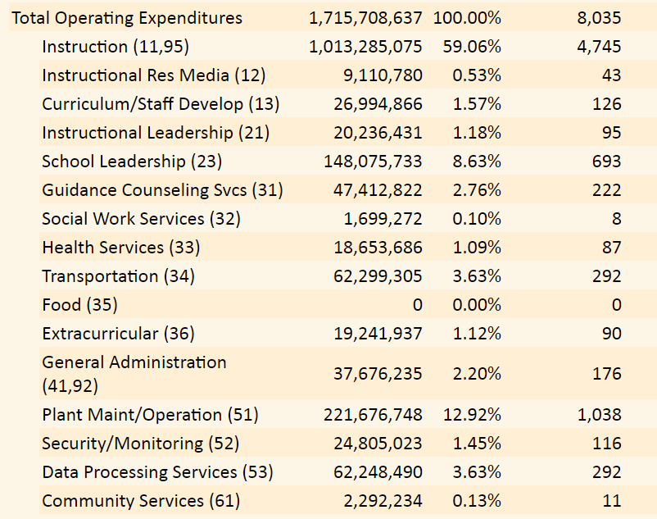
District Financial Report by Function (Texas)
Source: Texas PEIMS Financial Reports obtained from Texas Education Agency website.
Notes:
In Texas you can also see similar reports at the school level.

Slide 49
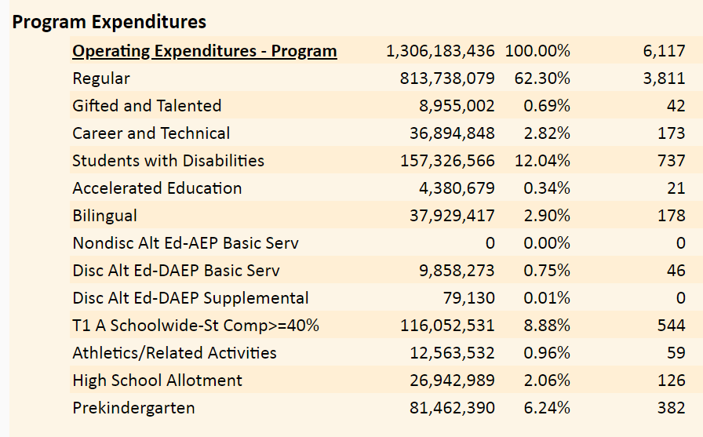
District Financial Report by Program (Texas)
Source: Texas PEIMS Financial Reports obtained from Texas Education Agency website.
Notes:
In Texas, you can also see similar reports at the school level.

Slide 50
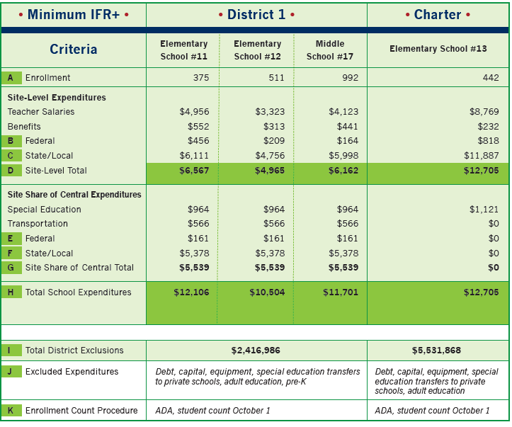
School-level Financial Report (Edunomics Lab)
Source: Interstate Financial Reporting by Edunomics Lab at Georgetown University
Notes:
Edunomics Lab recommends this type of view as a “baseline” to report school-level expenditures.
Sometimes schools in low-income communities don’t always get their fair share of dollars. Many district officials, including board members, remain unaware of these spending patterns that can shortchange schools by up to a $1M.

Slide 51
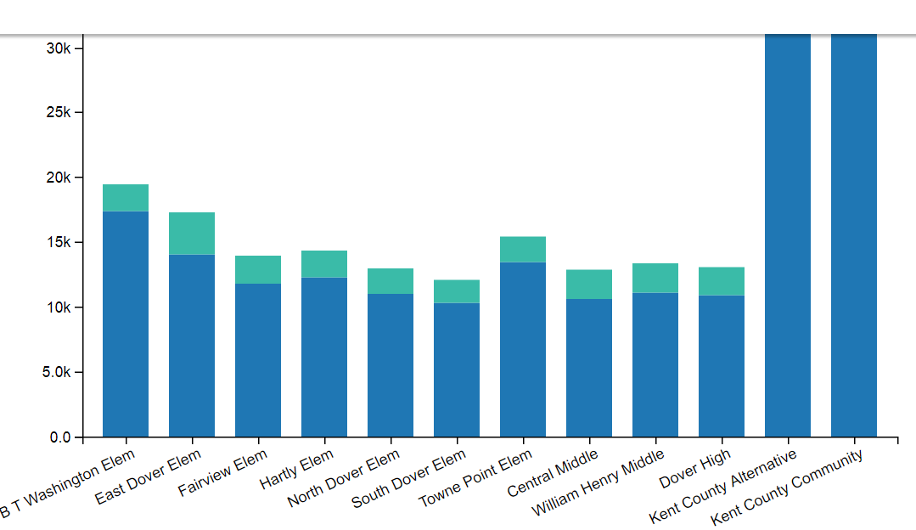
School-level Financial Report (Delaware)
Source: Delaware Department of Education
Notes:
Of course, you can make the data come to life with graphs, charts, dynamic tables, etc.
States must go above and beyond ESSA’s baseline requirements to get the most of the data. You can even pair it with academic outcomes.

Slide 52
Opportunity #3:
Equalize local dollars more effectively.
There are different approaches to consider. States reforms to study:
Tax Swap: Indiana, Michigan
Recapture: Wyoming, Texas
Local Revenue Restrictions: California
Statewide Property Tax: Vermont

Slide 53
Thank you

Slide 54
Appendix

Slide 55
Hawaii’s Transition to Weighted-student Funding
The transition plan for the implementation of the WSF in Hawaii included a scaled approach to the Board-adopted WSF. Schools losing funds under WSF would be compensated for lost funds according to the following percentages during the first three years of the program:
90% of the difference
75% of the difference
50% of the difference
None of the difference
Notes:
The funds used to supplement schools with losses under WSF would be generated from the additional dollars that schools with gains would have received.
Therefore, schools that would gain funding through WSF would have these phased in during the same period of time and at the same percentages.
However, during the 2007–08 school year, the BOE decided to accelerate the phase-in by adopting the COW recommendation to implement the WSF fully in the 2008–09 school year and protected schools only against losses caused by enrollment decreases.
To this end, in 2008–09, a loss threshold was established to ensure that no school lost more than 4.00 percent annually because of enrollment shifts. In 2009–10, it was determined that the total cost of these adjustments should not exceed 1.50 percent of the total WSF appropriation and that the loss threshold must adjust accordingly. The loss thresholds that resulted from these policy changes were as follows:
2008–09: 4.00 percent
2009–10: 6.82 percent
2010–11: 3.07 percent
2011–12: 7.41 percent
2012–13: Loss thresholds were eliminated

Slide 56
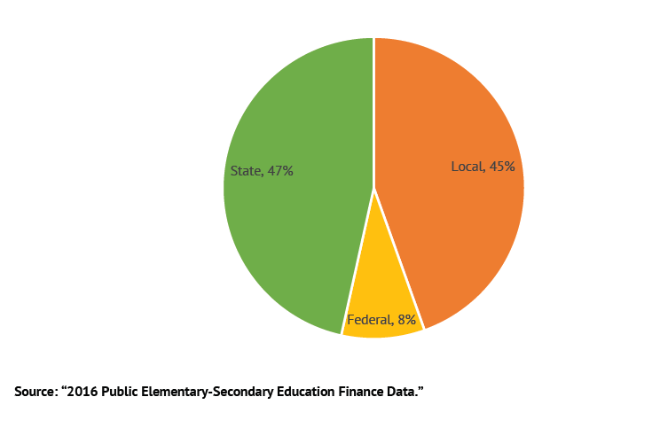
U.S. Education Revenue by Source

Slide 57
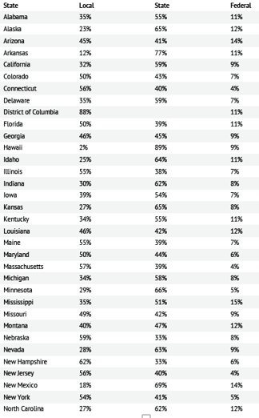
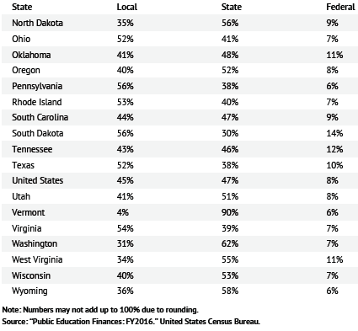
Notes:
Revenue source by state

Slide 58
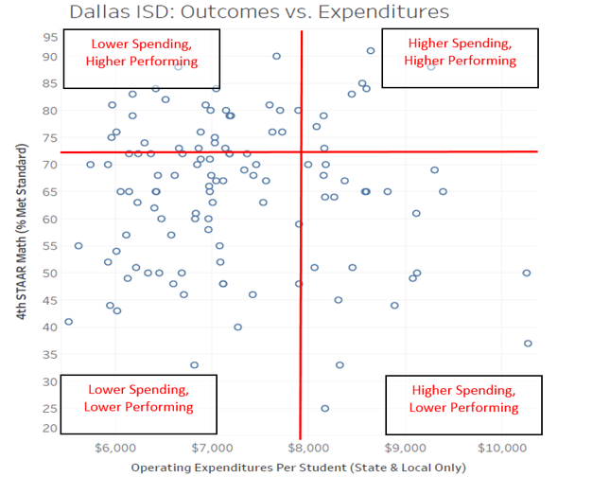

Slide 59
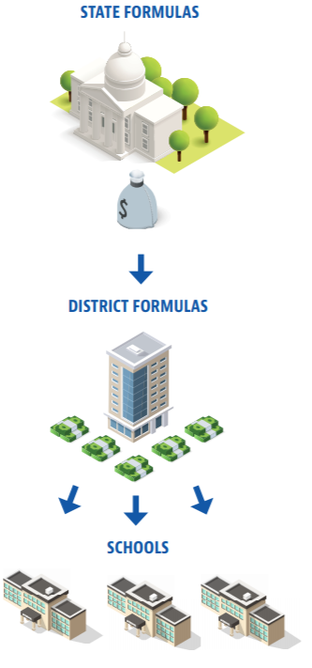
Education dollars pass through two sets of formulas before they reach schools.
Both state and district leaders have a role to play in school finance reform.
Notes:
Education dollars are allocated at two levels.
Policymakers shouldn’t ignore district allocation practices.
In today’s session we’ll discuss the problems and opportunities for reform at both levels.

Slide 60
What happens when there are cracks in the foundation?
Dollars don’t reach the students they’re intended for
Money is allocated based on outdated or arbitrary factors
Spending doesn’t align with student needs
Transparency is limited or non-existent
School finance is the foundation of public education.
Notes:
In summary, when a school finance system is broken then education dollars aren’t productive.

Slide 61
Adequacy Study Methodologies
Professional Judgment: Panel of education experts to develop optimal program/school from the “ground-up.”
Cons: Expensive and not necessarily tied to outcomes.
Evidence-based: Uses research on best practices to identify resources and costs required.
Cons: Also not tied to specific student outcomes.
Successful Schools: Analyzes top-performers and their costs.
Cons: Problem generalizing results to other districts where outcomes can vary substantially.
Econometric: Statistical approach to estimating spending levels.
Cons: Does not account for whether current spending levels are adequate or not.
Source: Funding Our Children for Success, Palmetto Institute

